Slide 1

Nigeria ASN Analysis 2025
Insights into Network Growth, Distribution, and Connectivity Trends
Courtesy of:
Raphael .S. Iloka
Manager
[Sales and Marketing, IXPN]
Date: 16th October 2025

Slide 2

Introduction
What is an ASN? An Autonomous System Number (ASN) is a unique identifier assigned to a network or a group of networks that operate under a single administrative entity.
Think of it like a company's unique phone number, allowing others to reach them directly.
Imagine a big building (network) with many offices (computers) inside. The ASN is like the building's address, helping others find and communicate with the offices inside.
What does an ASN do?
Routing, Network identification, Network Management,
Internet Connectivity, etc.

Slide 3

Objectives
Assess the state of Nigerian ASNs.
Identify the geographic distribution of ASNs
Determine the diversity of Networks
Inform network planning and resource allocation
Highlight opportunities for local interconnection and growth

Slide 4
Data Sources/Methodology
Data Sources:
AFRINIC Members List
Hurricane Electric
IXPN Internal Data
Analysis Parameters:
Network Category Distribution
ASN Status
Network Category Vs ASN Status
Geographical Distribution (State of Origin)
New ASN Allocation
ASN Reallocation and Delisted ASN
3-Year ASN Growth Trend
Nigeria Vs Others

Slide 5

Overview of ASN Growth in Nigeria
Total ASNs Allocated: 271 (Two hundred and seventy-one).
Trend: Lagos has the highest concentration of Autonomous System Numbers (ASNs) in Nigeria [167 = 61.62%], dominated by Internet Service Providers (ISPs) [78 = 46.71%].
Abuja follows [49 = 18.08%], with ISPs also making up a significant portion of its ASN landscape [24 = 48.98%].
New ASN allocations indicate continued growth in the ISP sector [6 out of 15], with Lagos [8] and Abuja [4] being the primary hubs for these new entrants.
In 2025, only 1 member was delisted from the ASN list, indicating a notable improvement in ASN management and stability by Nigerian ASN holders, compared to previous periods.

Slide 6
Network Category Distribution
Breakdown of 271 ASNs:
• ISPs – 129
• MNOs – 4
• CDNs – 1
• Financial Institutions – 41
• Enterprise Networks – 32
• Educational Institutions – 27
• Others – 37

Slide 7
ASN Status [Active Vs Inactive]
Total ASN – 271
Active ASN – 236
Inactive ASN – 35

Slide 8
Network Category Vs ASN Status
• ISPs – 129
(Active – 117) (Inactive - 12)
• MNOs – 4
(Active - 4) (Inactive - 0)
• CDNs – 1
(Active - 1) (Inactive – 0)
• Financial Institutions – 41
(Active 38) (Inactive – 3)
• Enterprise Networks – 32
(Active – 25) (Inactive – 7)
• Educational Institutions – 27
(Active – 21) (Inactive – 6)
• Others – 37
(Active – 30) (Inactive – 7)

Slide 9
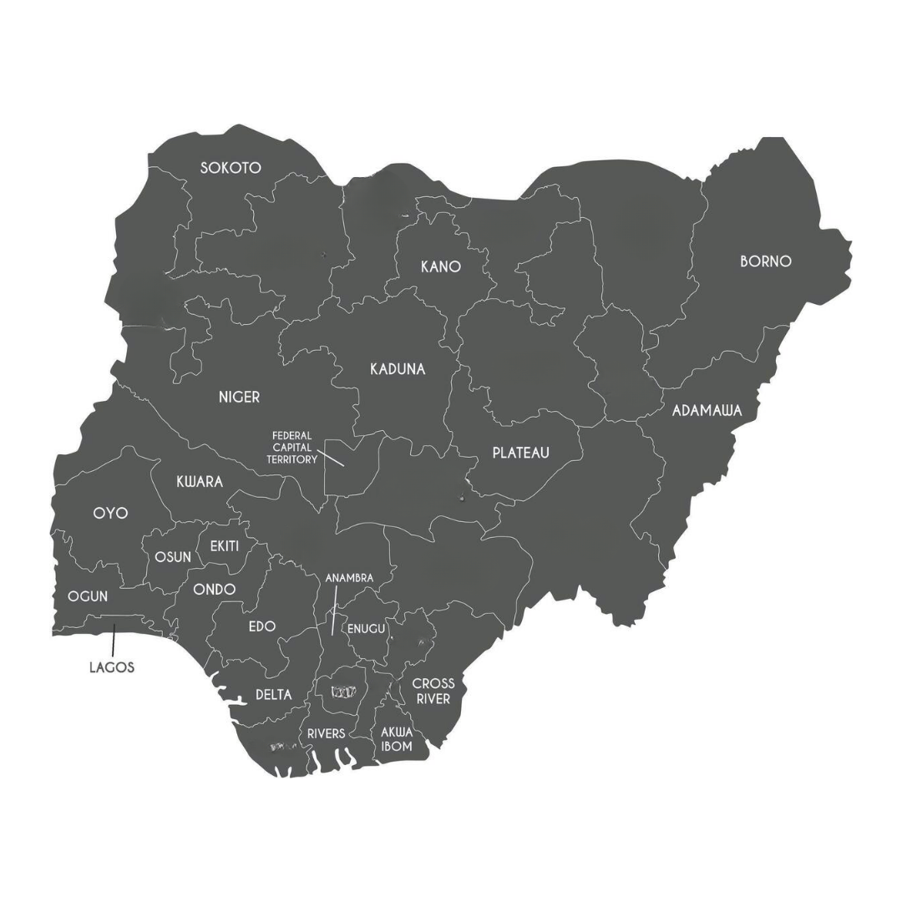
Geographical Distribution (State of Origin)
Lagos – 167
Abuja [FCT] – 49
Rivers – 9
Oyo – 6
Ogun – 6
Kano – 6
Osun – 4
Kwara – 3
Delta - 3
Enugu - 2
Adamawa – 2
Edo – 2
Ekiti - 2
Akwa Ibom – 2
Kaduna - 1
Ondo – 1
Cross River – 1
Borno – 1
Niger – 1
Anambra – 1
Plateau – 1
Sokoto - 1
22 states in Nigeria have at least one ASN, while 15 states have none. This represents a 19% difference between states with ASN presence (59.5%) and those without (40.5%).

Slide 10
New ASN Allocation 2025
Total new ASNs allocated: 15
Breakdown by Network Category:
ISPs (Internet Service Providers): 5
ENs (Enterprise Networks): 4
FIs (Financial Institutions): 3
EI (Educational Institutions): 1
Others: 2
Breakdown by location: 15
Lagos: 8
Abuja: 4
Rivers: 2
Oyo: 1

Slide 11
ASN Reallocation and Delisted ASN
ASN Reallocation:
2 Organizations that previously lost their ASN have been allocated a new one, different from their original ASN.
Delisted ASN:
The number of delisted ASNs this year (1) is significantly lower than the last two years, marking a substantial improvement in ASN stability and management.

Slide 12


3-Year ASN Growth Trend
The ASNs in Nigeria have shown a fluctuating growth trend over the past three years:
- 2023: The total ASN count was 269.
- 2024: The count dropped to 256, representing a decline of 4.8% from the previous year.
- 2025: The ASN count has rebounded to 271, indicating a growth of 5.9% from 2024.
The initial decline in 2024 could be attributed to several factors. However, the rebound in 2025 suggests an expansion in internet services, possibly driven by increased demand for digital services or existing network upgrades.

Slide 13
Nigeria Vs Others
ASNs allocated to a country reflect its internet infrastructure development and connectivity.
Key Observations:
Nigeria has 271 ASNs, suggesting opportunities and a need for growth and development.
South Africa has 742 ASNs. Making them the highest in Africa.
Africa has 2,452 ASN according to the AFRINIC record, and this calls for an intense continental digital infrastructure development.
Germany ranks 7th globally with over 3,100 ASNs.
Brazil leads globally with over 9,000 ASNs, showcasing its advanced internet infrastructure.
These numbers highlight the need for investment and development in Nigeria's internet infrastructure.

Slide 14

Key Insights & Observations
Growth in Digital Infrastructure: 15 new ASN allocations indicate expansion in Nigeria's digital infrastructure.
Stability in ASN Management: With only one ASN delisting in 2025, this demonstrates improved stability in ASN management.
Lagos and Abuja Dominance: These cities still lead in ASN allocations, but gradual expansion to other regions is evident.
Diverse Organizational Participation: New ASNs held by various organizations (ISPs, enterprises, financial institutions, etc.) showcase a diverse digital ecosystem.
Positive Trend: Overall, the ASN analysis suggests a positive trend in Nigeria's internet infrastructure development, with growth, stability, and gradual expansion.

Slide 15

Conclusion
Concentration in Key Regions: The majority of ASNs are concentrated in Lagos, Abuja, Rivers, Kano, Oyo, Ogun, and Osun, which serve as digital and commercial hubs, highlighting regional disparities of networks.
Need for Regional Expansion: Some states [15] still lack active ASNs, emphasizing the need for awareness, capacity building, and infrastructure investment to deepen Internet penetration nationwide.
The ASN landscape in Nigeria reflects a maturing Internet ecosystem, one that’s expanding in diversity, capacity, and strategic significance. To fully harness its potential, there is a need for stronger regional participation, improved interconnectivity, and sustained collaboration across networks to drive true digital inclusion and national resilience.

Slide 16


Thank you!
Questions, Comments, or Contributions?

