Slide 1
Introduction for Peering Engineers (ngNOG Workshop)
Obinna Adumike
Obinna@peeringdb.com

Slide 2
Why Peering Engineers Should Care

Slide 3
Agenda
What is PeeringDB?
Key data objects and UI elements
Why peering engineers and organizations should care
Step-by-step: create account → claim/affiliate → manage records
Advanced/technical: API, automated networks, privacy, roles
Geography & maps: KMZ / Google Earth, searches and exports
Best practices and workflow examples
Q&A / Hands-on lab suggestions

Slide 4
What is PeeringDB?
Community-maintained & authoritative registry of interconnection data.
Stores info about: Networks (ASNs), Organizations, Facilities (data centers), Exchanges / IXPs, Carrier/Campus objects and Connections.
The go-to place to discover who is at which facility and who peers where.

Slide 5
What is PeeringDB?
Why should my exchange, network or facility be listed in PeeringDB?
Helps establish new peering more efficiently, with all information easy to find in one place
  Maintain all of your contact and connection info
  Find other network's peering contact and connection info
  Find interconnection facility and IXP info
A PeeringDB record is required by many networks to peer
Can be used for automation to generate router configurations
  Initial configuration to setup peering quickly
  Update configuration if maximum prefixes change

Slide 6
Governance and Membership
PeeringDB is a United States 501(c)(6) volunteer organization that is 100% funded by sponsorships
Healthy organization, building financial reserves and executing the long-term strategic plan
Membership rules
  A corporation, limited liability company, partnership or other legal business entity may be a Member of the Corporation
  Membership is determined by having both an active PeeringDB.com account and an individual representative or role subscription to the PeeringDB Governance mailing list
  503 addresses subscribed to the Governance mailing list (as of April 8, 2025)
  Governance list is at https://lists.peeringdb.com/cgi-bin/mailman/listinfo/pdb-gov
  More information available at https://docs.peeringdb.com/gov/

Slide 7
Main PeeringDB objects
Organization (org): legal/company entity — owns networks and facilities.
Network (net): ASN record, peering policy, contact points, IRR/looking glass.
Facility (fac): physical data center, who’s present and cage/space details.
Internet Exchange / Exchange (ix): peering LANs and exchange objects.
NetIXLAN / Network-to-IX connection objects: which ASN is present on which IX and at which port/VLAN.
Carrier / Campus / Other auxiliary objects

Slide 8
Why peering engineers should care
Knowing whether a prospective peer is at the same facility or IX reduces procurement delays.
Peering policies and contact info make outreach faster and more effective.
Allows automated tooling to populate local peeringDB-derived configuration, dashboards and alerts.
Reduces duplicate manual research and minimizes peering mistakes.

Slide 9
Why organizations, datacenters, networks should use PeeringDB
Datacenters/facilities: advertise who’s present and what IXs are accessible; increases attractiveness.
Networks: publish peering policy, presence, and contact points for quick onboarding.
IXPs: list exchange details, participant counts, and connection options to attract members.
Public, trusted source improves transparency and speeds up partner evaluation.

Slide 10
How accurate data helps operations (examples)
Example 1: Engineer sees ASN and peering policy -> knows whether to request private peering or public peering.
Example 2: Operator finds presence in facility -> arranges cross-connect faster.
Example 3: Automation uses API to populate visibility dashboards and remove stale peers.

Slide 11
Roles & permissions
User: basic profile, can request affiliations.
Org Admin: manage org, approve affiliations, add networks and contacts.
Network Admin: edit network-specific data and manage NetIXLAN entries.
Facility Admin / IX Admin: manage facility or IXP data.

Slide 12
Step-by-step: create a PeeringDB account
Go to https://www.peeringdb.com and click Sign Up / Register.
Provide email, name, and choose a strong password.
Verify your email by clicking the link sent to your inbox.
Log in and complete your user profile (name, role, contact preferences).
Once validated, enable MFA

Slide 13
Step-by-step: affiliating (claiming) an organization
After logging in, search for your Organization or Network record.
If your org exists: request affiliation by clicking Request Affiliation on the org page and select your user account as the requester.
Provide proof of affiliation if asked (company email, official confirmation) — follow the on-screen instructions.
If your org doesn’t exist: create a new Organization record and fill in legal name and basic details, then create or claim Network(s).
Organization admins can approve/deny affiliation requests through their account management UI.

Slide 14
Step-by-step: creating or updating a Network record
From your org page, click Add Network or find existing net record and choose Edit (if you have permission).
Fill required fields: ASN, network name, website, IRR AS-SET (if any), peering policy (Open/Selective/Restrictive/None), IX and facility presence.
Add contact persons (technical, peering, abuse) with emails and roles.
Save and review. Changes may be subject to moderation.
Use the Automation section to register an API key for automated updates if needed.

Slide 15
Automation & API
PeeringDB provides a RESTful API for read/write operations.
Typical uses:
  Sync presence information from internal inventory (DCIM) to PeeringDB.
  Populate monitoring dashboards and maps.
  Automate bulk updates (e.g., change contact emails when team rotates).
Best practices:
  Use API keys tied to a service account.
  Rate-limit and cache queries; avoid overly frequent writes.
  Add logging and alerting for failed syncs.

Slide 16
Using PeeringDB with Google Earth (KMZ export)
PeeringDB supports geographic exports (KMZ/KML) that can be viewed in Google Earth and other GIS tools.
Common workflow:
  Run your search or Advanced Search on PeeringDB to filter facilities or exchanges of interest.
  Use the Export option and choose Google Earth KMZ (or the KMZ link in the site footer/exports area).
  Download the .kmz file and open in Google Earth (or import into your GIS tool).
  Each placemark includes facility/IX metadata — click to inspect details and presence.
Use KMZ for visual planning: distance checks between facilities, cluster analysis, and meetup/roadmap planning.

Slide 17





Information and Resources
Announce list: http://lists.peeringdb.com/cgi-bin/mailman/listinfo/pdb-announce
Governance list: http://lists.peeringdb.com/cgi-bin/mailman/listinfo/pdb-gov
Technical list: http://lists.peeringdb.com/cgi-bin/mailman/listinfo/pdb-tech
User Discuss list: http://lists.peeringdb.com/cgi-bin/mailman/listinfo/user-discuss
Docs, presentations, guides, tools: http://docs.peeringdb.com/
Board and Officers: stewards@lists.peeringdb.com
Admins: support@peeringdb.com
Presentation requests: outreachcom@lists.peeringdb.com
Uptime status: http://status.peeringdb.com/
Bugs and feature requests: https://github.com/peeringdb/peeringdb/
Social media:
https://www.facebook.com/peeringdb/
https://www.linkedin.com/company/peeringdb
@PeeringDB
https://www.youtube.com/channel/UCOrYWUg-dbL9UTFV_Lry6Wg

Slide 18
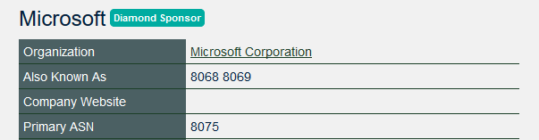

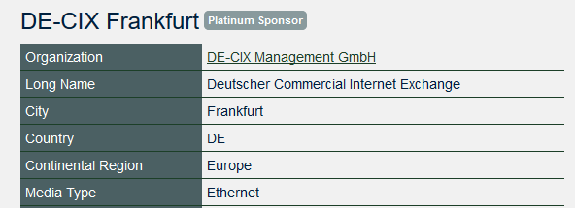




Become a PeeringDB Sponsor!
Diamond Sponsorship - $25,000 / year
  Limited to ten sponsors
  Very large logo on top line of Sponsors page with URL
  Diamond Sponsor badge display on all records
  Social media promotion
Platinum Sponsorship - $10,000 / year
  Large logo on second line of Sponsors page with URL
  Platinum Sponsor badge display on all records
  Social media promotion
Gold Sponsorship - $5,000 / year
  Medium logo on third line of Sponsors page
  Gold Sponsor badge display on all records
  Social media promotion
Silver Sponsorship - $2,500 / year
  Small logo on fourth line of Sponsors page
  Silver Sponsor badge display on all records
  Social media promotion
Contact sponsorship@peeringdb.com for sponsorship info!

Slide 19
Committees
Admin Committee | Operations Committee | Outreach Committee | Product Committee
Manage administration of user accounts and PeeringDB records Answer support tickets Cleansing and completion of PeeringDB records Leads: Chriztoffer Hansen (Chair) and Peter Helmenstine (Vice Chair) Contact: admincom@ lists.peeringdb.com | Manage PeeringDB infrastructure Leads: Job Snijders (Chair) and Aaron Hughes (Vice Chair) Contact: pdb-ops@ lists.peeringdb.com | Manage marketing and social media Develop and maintain presentations, workshops and webinars Coordinate presentations and attendance at events Leads: Ben Ryall (Chair) Contact: outreachcom@ lists.peeringdb.com | Manage roadmap and development priorities Ask for input from the community on desired features Write SoWs to solicit bids to complete requested features Leads: Jack Carrozzo (Chair) and Matt Griswold (Vice Chair) Product Manager: Leo Vegoda Contact: productcom@ lists.peeringdb.com

Slide 20






Board of Directors and Officers
Shawna Bong – Secretary and Treasurer | Alexandre Corso – Director (Term Expires 2027) | Aaron Hughes –President (Term Expires 2026)
Livio Morina – Vice President (Term Expires 2027) | Isabel Odida – Director (Term Expires 2027) | Job Snijders – Director (Term Expires 2026)

Slide 21







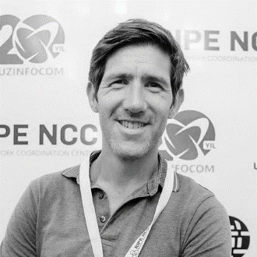




Admin Committee
Ankesh Anand | Austin Brower | John Brown | Budiwijaya | Shaun Coffey | Ron Grant | Chriztoffer Hansen – Chair | Peter Helmenstine – Vice Chair
Gaël Hernandez | Adam Korab | Chris Malayter | Aquinas Masakha | Crisóstomo Mbundu | Julimar Mendes | Laura Yepes

Slide 22

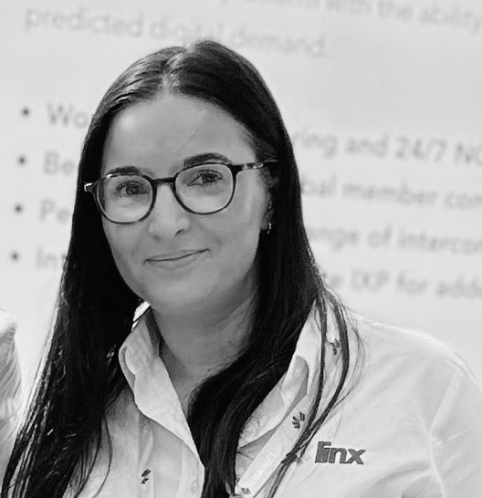




Outreach Committee
Obinna Adumike | Lynsey Buckingham | Greg Hankins | Aaron Hughes – Board Liaison | Tarryn Kidd
Livio Morina | Arnold Nipper | Ben Ryall – Chair | Leo Vegoda – Product Manager

Slide 23









Product Committee
Jeff Bartig | Yan Berthier | Jack Carrozzo – Chair | Yolandi Cloete | Matt Griswold – Vice Chair | Martin Hannigan | Peter Helmenstine
Paul Hoogsteder | Aaron Hughes –Board Liaison | Laurent Jarbinet | Stephen McManus | Arnold Nipper | Terry Sweetser | Leo Vegoda –Product Manager

Slide 24





















































Thank you to our sponsors!

